Slide 1

R&I for a fair digital transition
project review and policy analysis

Slide 2
Outline of the Report
H2020 SSH projects data analysis
Bibliometrics
Experts’ highlights
Recommendations

Slide 3
Policy landscape: Digital Compass
skills,
infrastructures,
digital transformation of businesses
public services

Slide 4
Policy aim:
Human dimension of digital ecosystem
Competitiveness
Wider benefits to society
Business development

Slide 5
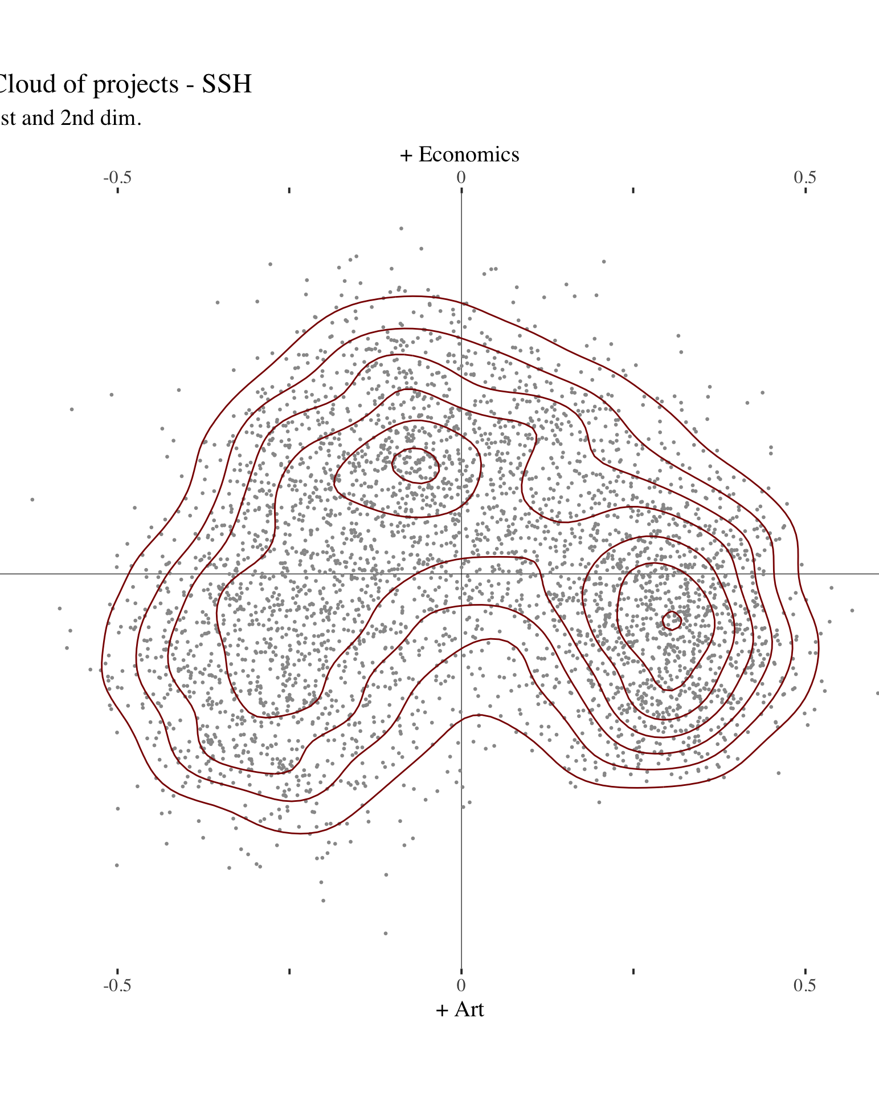
SSH in H2020: Digital transition & employment
Economics
Business to market
Products
Technology
(Labour to social concerns)
Utilitarian nature

Slide 6
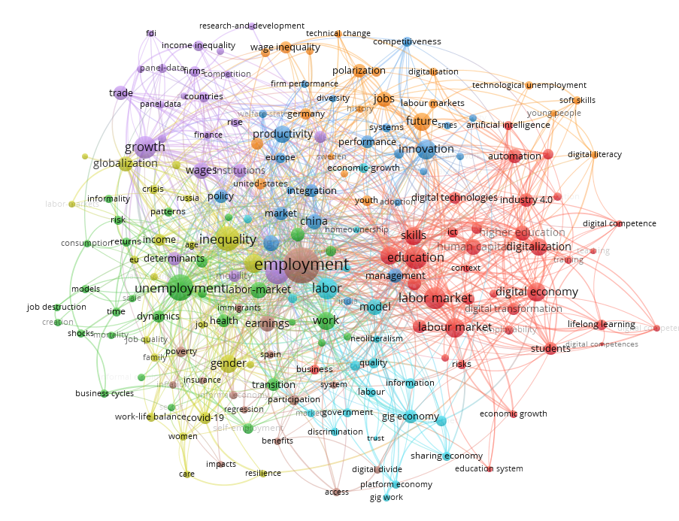

Publications
Small number of DT contents
Digital transition $≠labour market$
Scattered interests – wide range of issues
Utilitarian/product related/Technology based

Slide 7
Topics and themes
Education (red cluster)
  Introduction of new digital technologies and capabilities in to the economy Change nature of employment
  From learning by doing, to learning by training
  Soft skills more than digital skills
  Short term relevance of micro-credentials
Entrepreneurship vis a vis gig economy (green cluster)
  health, precarity, poverty)
  Mobile and diverse labour (cross borders, age, competence, capacities, abilities)
competitiveness, innovation, productivity, and immigration (blue cluster)

Slide 8
Experts’ analysis
Online Platform and Digital or Automated Labour Market
Platforms Capitalism and Inequalities in online transactions
Digital Public Administration
New technologies in public administration and public services: implications on citizen-public institutions trust relationship
New technologies in public administration and public services: implications for citizens and recipients of public services – usability of digital solutions; problems of bias in using digital solutions in delivery of public services
New technologies in public administration and public services: implication in labour market and public employment
Digital Welfare
Digital Labour Market
Data stewardship
Ethics and Responsible Transition
Health and Wellbeing
Unemployment
Digital Transition's Narrative
Categorization, heterogeneity, fields of application
Democracy of Big Tech companies
Participative model for digital transition
Fair access
Equality / Inequality

Slide 9
Experts’ analysis (2)
Digital Infrastructure
Cultural and Creative Industries
Broadcasting Live Performances
Digital relation between performers and public
The impact of digital infrastructure and digital work on the environment
Digital infrastructure and data government: differences among different societies and role of humans in AI
Impact of Social Media and Jobs on skills
Blockchain in CCI
DNA-based future repositories
SSH literature on digital
Identity
Mass digitalisation, Social Media impact on Identity Race

Slide 10
Recommendations
Research disciplines and perspectives
Behavioural studies
Inequalities – social and economic gaps
Challenges and opportunities in changed pattern of employment
Fair AI: ethics, pub administration, discrimination, social exclusion, legal frameworks
Policy areas, priority themes and topics
Creativity, soft skills, gig economy/self-employment
Community/individual identity; literature; historical trends
Social policy: new tools; family dynamics; population studies; health/wellbeing
Programme processes and architecture
Emerging new policies; new social care tools;
HE and research ecosystem: Research on research tools and methods

Slide 11
Thank you

