Slide 1
R&I FOR A FAIR GREEN TRANSITION: PROJECT REVIEW AND POLICY ANALYSIS

Slide 2
Outline of the Report
H2020 SSH projects data analysis
Bibliometrics
Experts’ highlights
Recommendations

Slide 3
The Green Deal: climate neutral by 2050
Green technology
1
Create sustainable industry and transport
2
Cut pollution
3

Slide 4
Impact on society Human and social costs of the green transition
Economics:
capital expenditures
Political
different national energy development models
Fighting energy poverty
Social
Regions which depend on fossil fuels and carbon-intensive industries
Improving households
Human costs
Employment in new trades
Historical and identity of communities

Slide 5
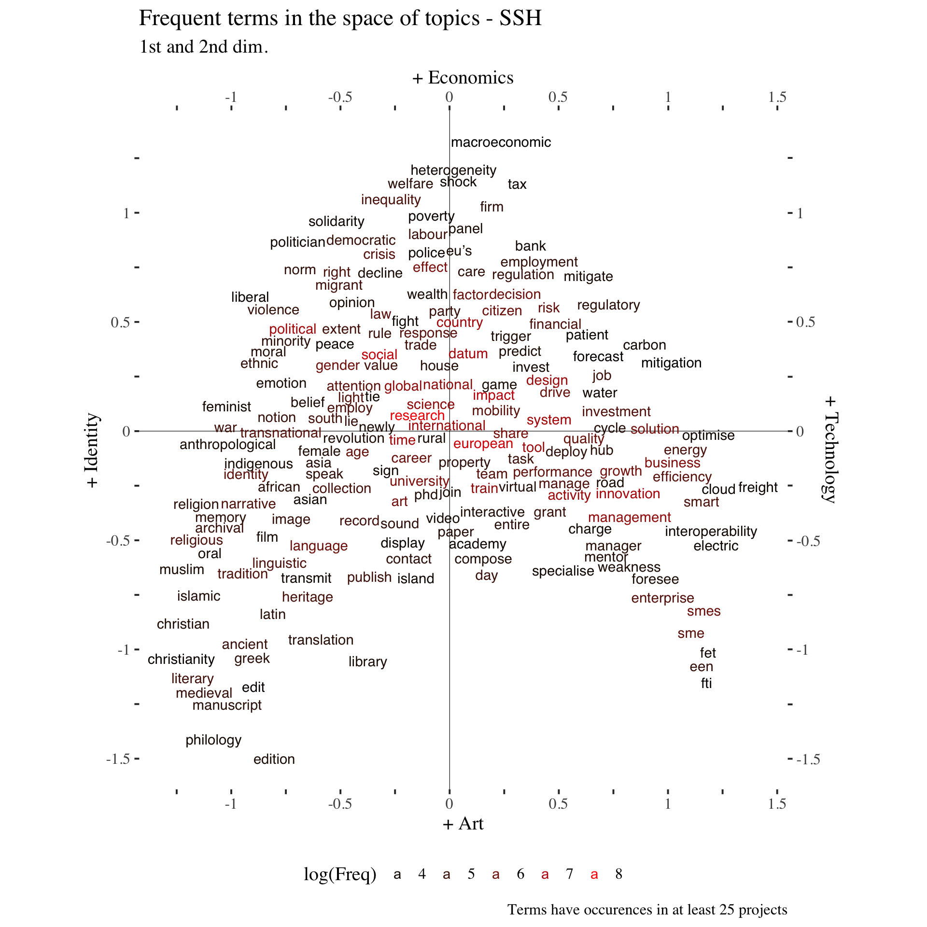
H2020: SSH space
Technology
Economics/Market
Political vis a vis market solutions
Products vs Research to solve challenges
Qualitative vs Quantitative approach

Slide 6
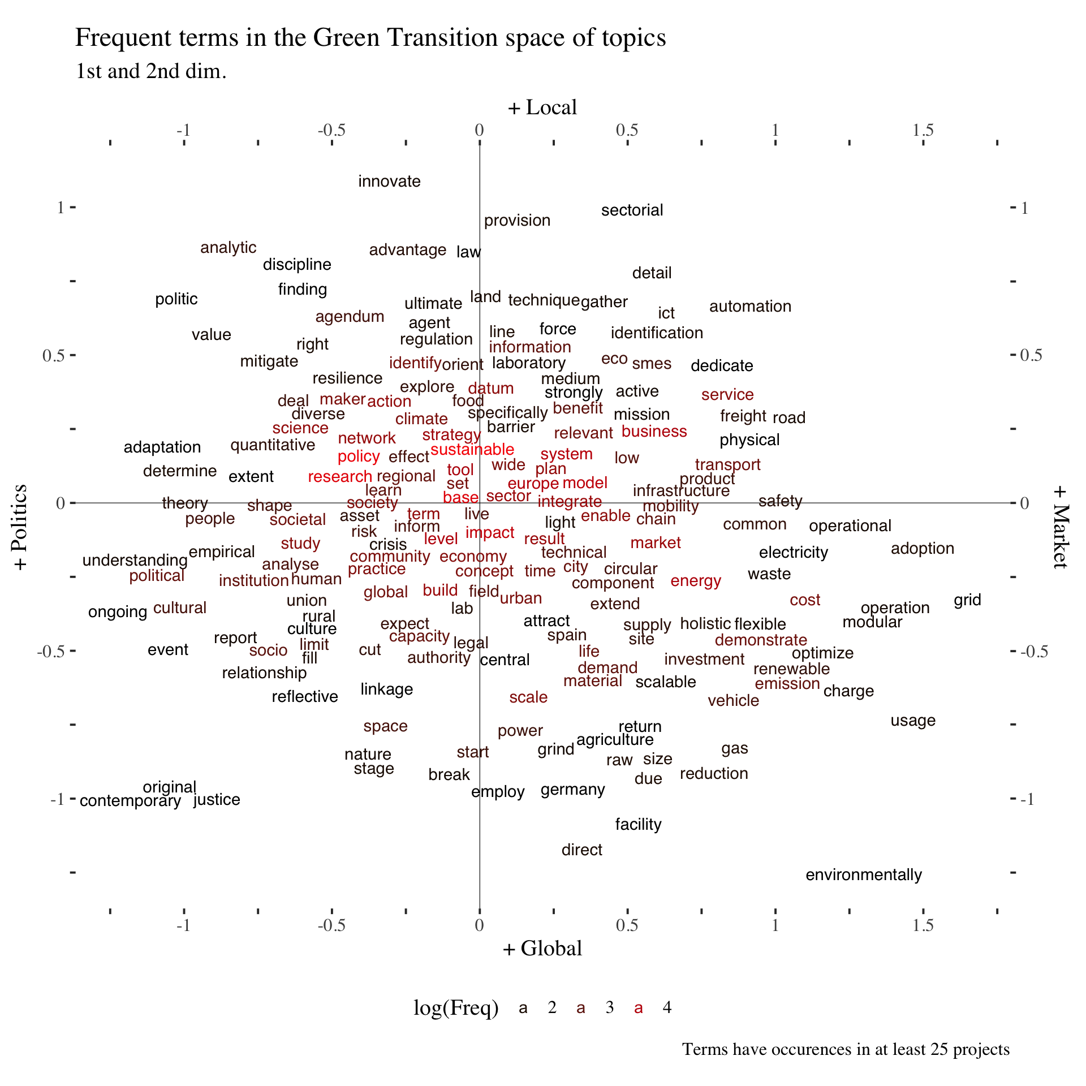
Green transition in projects
Local vs global (municipalities, cities)
Local: Climate (flooding, renewable energy
Global: Environment (rising temperatures, weather patterns)
Urban studies:
Transports
Infrastructures
Resources
The divide between political/policy solutions and market driven product solution is clear in this map too

Slide 7
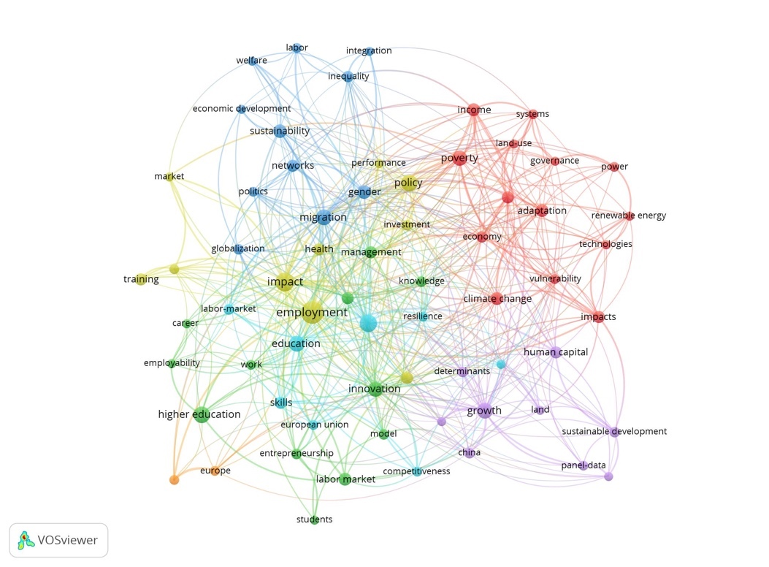
Publications feedback
Adaptation: labour mkt & poverty (red)
Climate change (blue)
Employability/Employment (green/gold)
Entrepreneurship (green)
Education (green)

Slide 8
Understanding the problem (experts’view)
More qualitative studies
More combined quantitative and qualitative studies
Education & Human centric solutions
Research which connects the local and global dimension

Slide 9
Recommendations: New research trends
Social disruption and transition, psychological trade-off (Culture, society)
Communities around industries, such as natural resources extraction, manufacturing industries or agricultural sectors (Identity, longitudinal studies, historical studies)
Theoretical and methodological approaches framing GT (socio- economics)
Modelling of environmental decisions, innovative environmental comms (Adaptability, Employability, Entrepreneurship, Education, skills, vocational education, life-long learning)
Behavioural studies in social and structural contexts (social policy analysis, social provisions)
Differential impacts at local, regional, cross-border and national levels (legal studies across borders)
Impact on different business sectors and social groupings (age, gender, education, and nationality related to migration/mobility/population studies)
The social implications of Green transition - it is however opposed to the market green transition.

Slide 10
Thank you

